Slide 1

LIST OF DOCUMENTS
( LOD )

Slide 2
Process of LOD
Opening Script - Welcome to Grihum Housing Finance Limited. My name is (Agent Name) How may I assist you?
Customer - I want LOD
AI - Please note that this call is being recorded for quality assurance and training purposes.
AI - To verify the information, kindly provide the registered mobile number. ( To check the details in finnone slide 3)
Verification - Any 3 of the below verification questions needs to be answered ( To verify the customer details slide 4 )
NAME
Date of Birth
Registered Email ID
Loan Sanction Amount
EMI Amount
AI - Thank you, Sir/Madam. Your verification has been completed. If there are two LANs, AI should first confirm the specific sanctioned amount, as the LAN number is not remembered Once confirmed, proceed with the relevant LAN number. Check Point: FinnOne, Slide 4.
AI- May I know the purpose for which you require the LOD?
Customer – due to personal reason / Forecloure
AI – Please note that charges are applicable for the LOD. The total charges are ₹590, inclusive of 18% GST.
AI – We are raising a request for the LOD and the LOD will be issued and sent to your registered email ID within 21 working days.
AI - Any other details required apart from this?
Thankyou for calling Grihum Housing Finance Limited. Have a pleasant day!

Slide 3
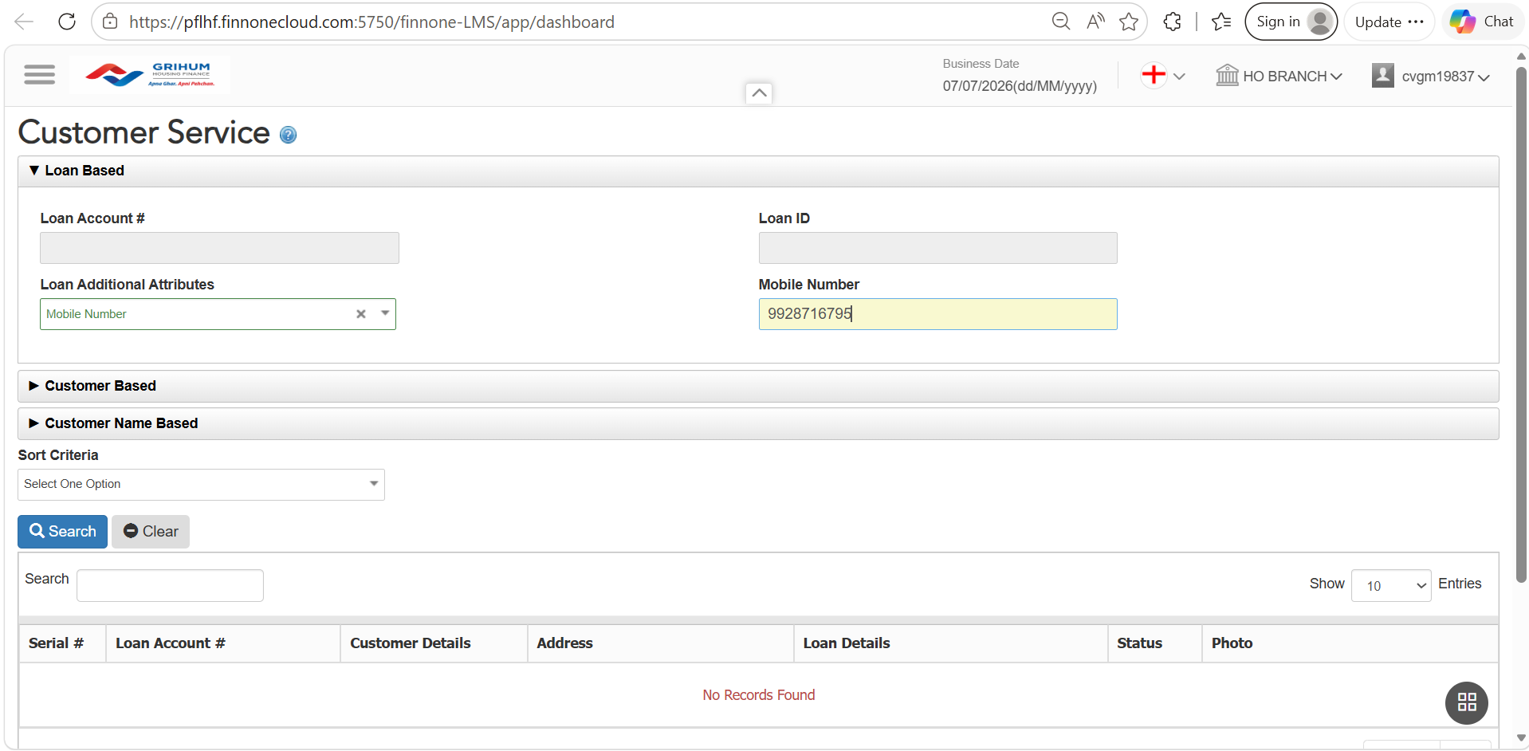
FINONE ​
To verify the information, please provide the customer's registered mobile number.​
​

Slide 4
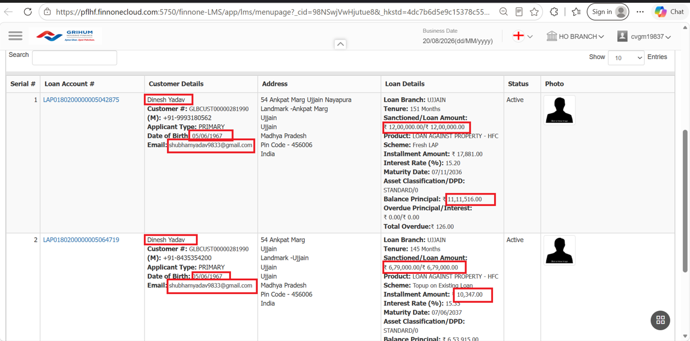
Verification - Any 3 of the below verification questions needs to be answer

Slide 5
CSR TAGGING​

Slide 6
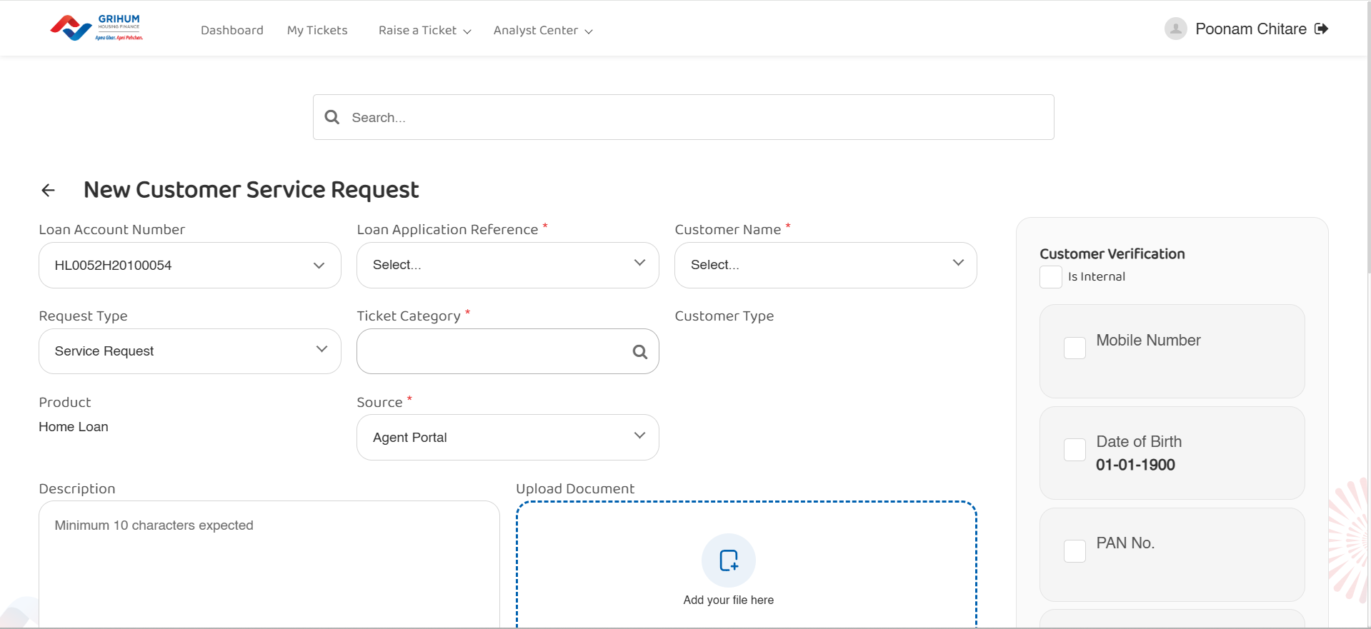

Slide 7
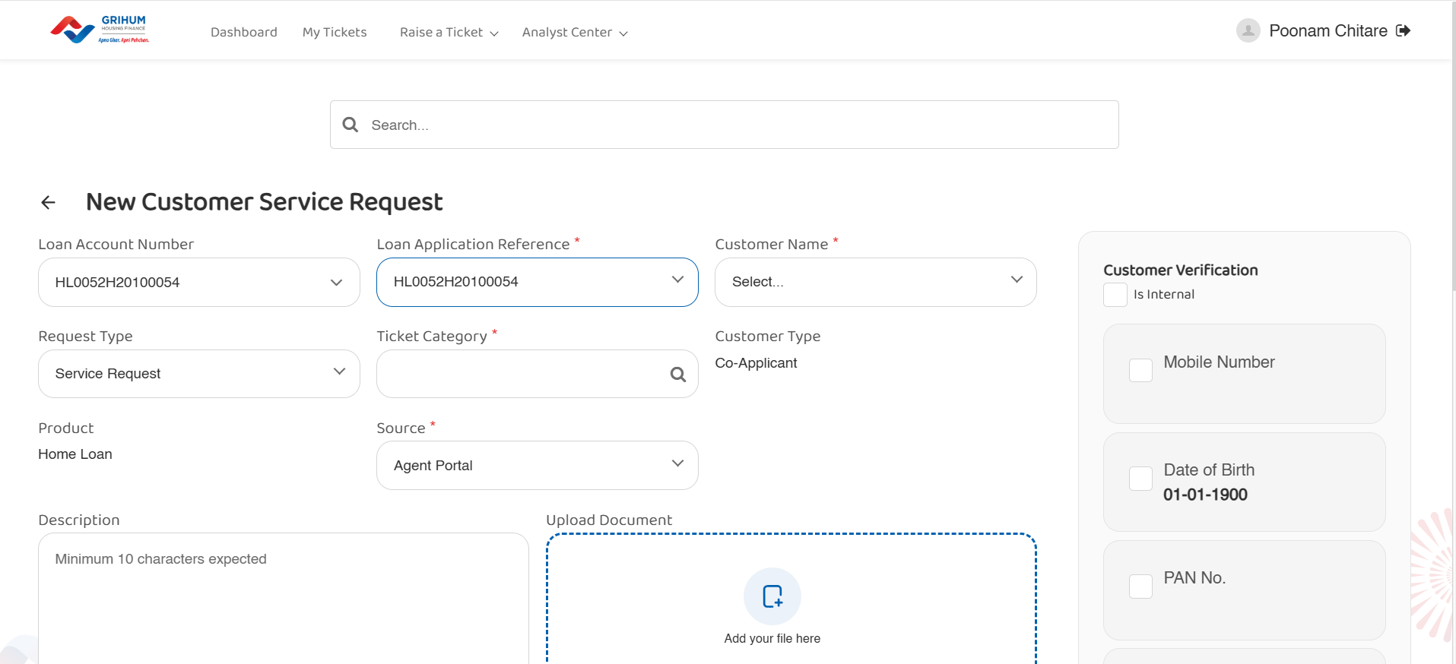

Slide 8
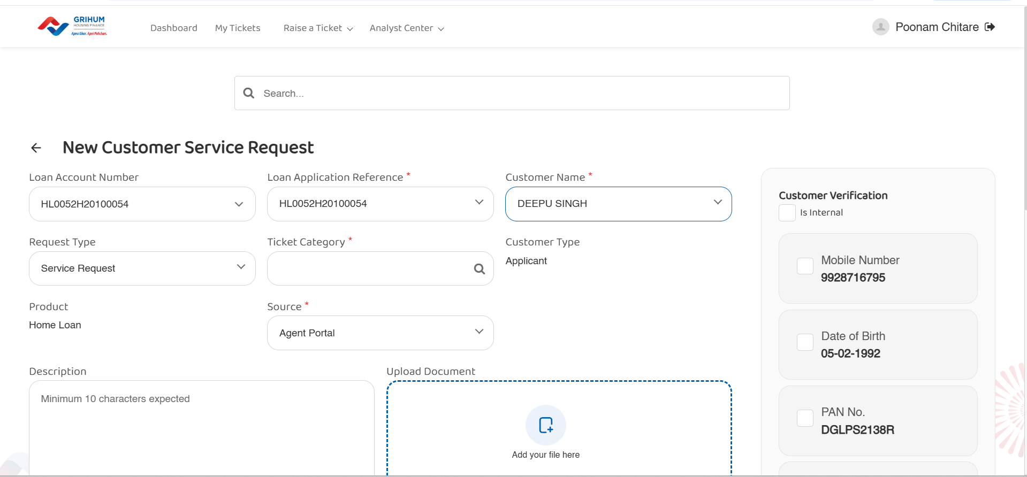

Slide 9
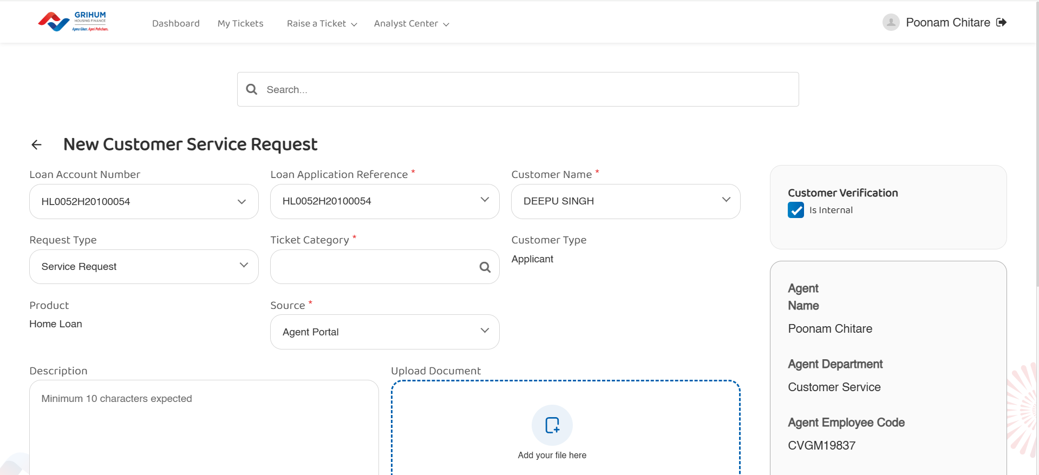

Slide 10
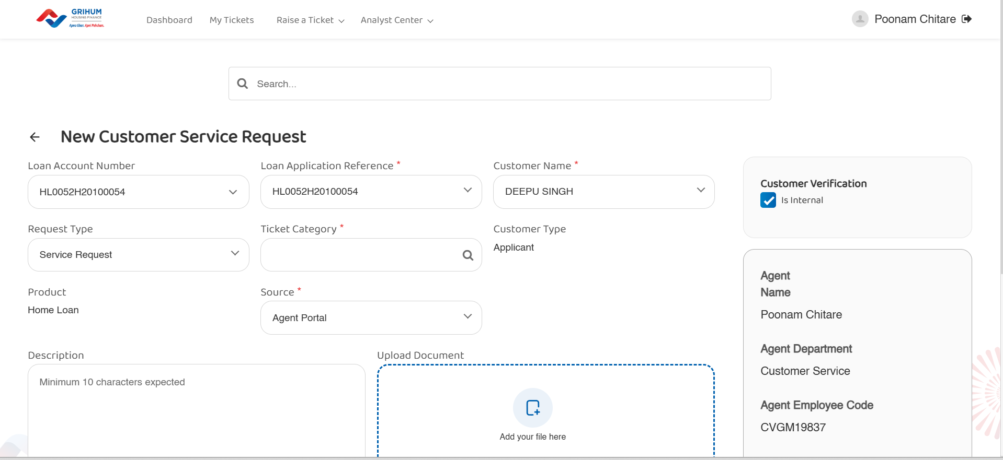

Slide 11
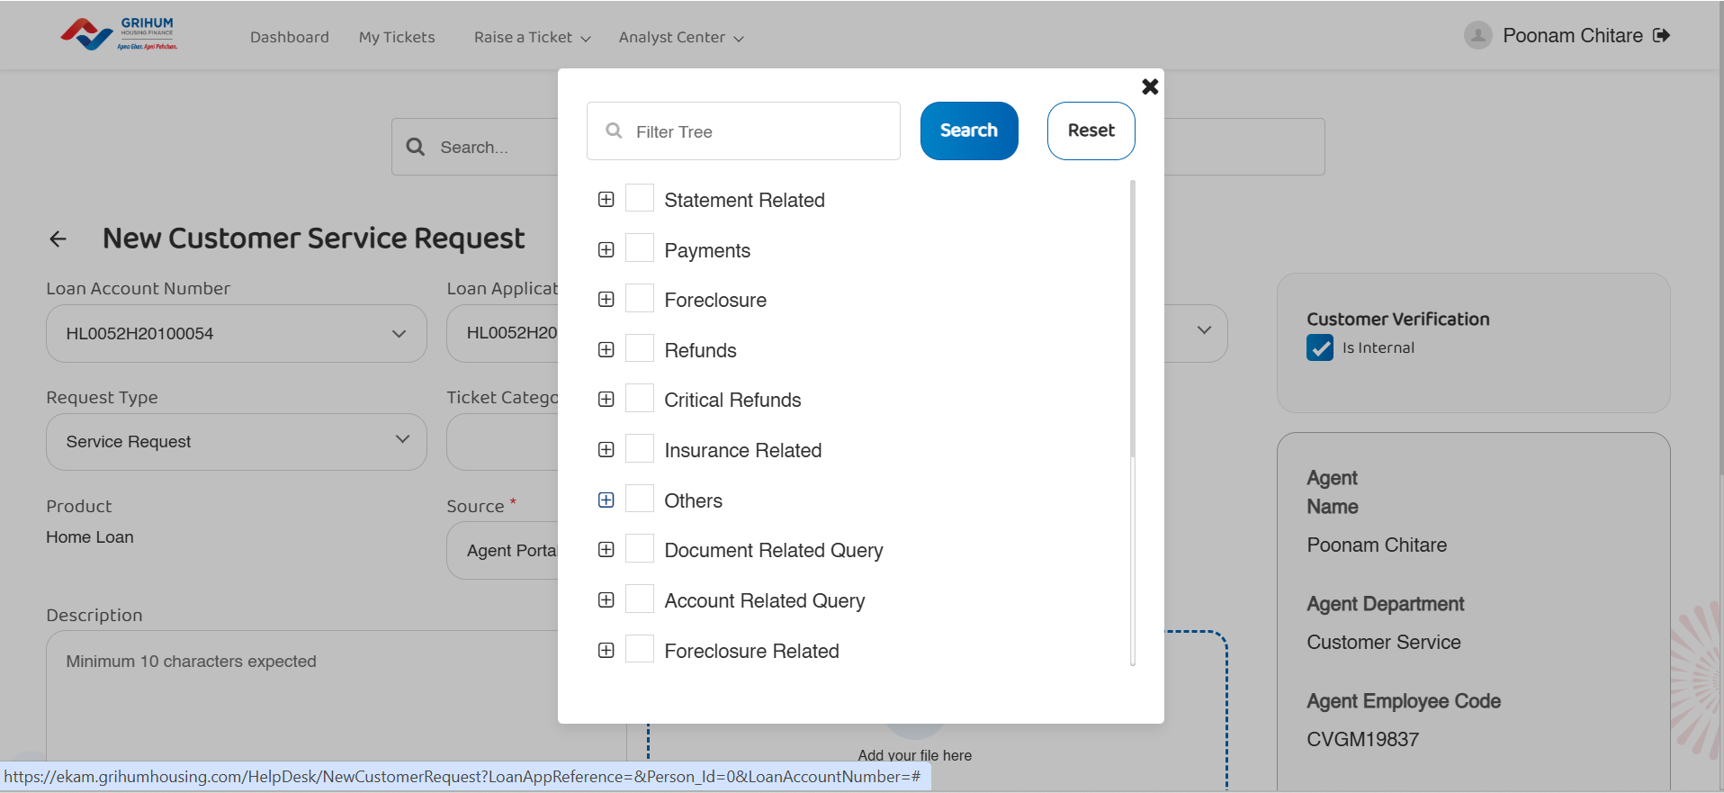

Slide 12
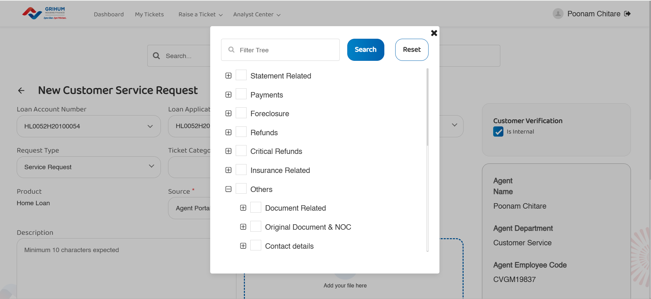

Slide 13
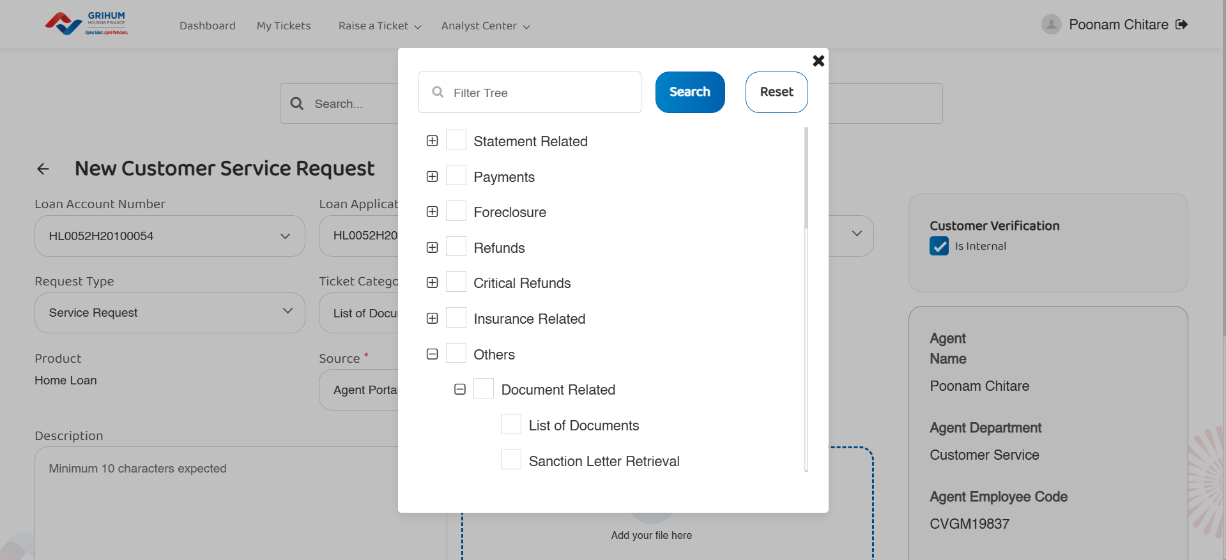

Slide 14
